Slide 1
Agenda – Jeffords 326 (April 6, 2019)
9:00-9:30 – Introductions & roles - John
9:30-10:00 – Project Background – Tucker
10:00- 10:30 – Timeline of activities and annual milestones - Deb
10:30-11:00 - Results from initial industry survey - Tucker
11:00-11:30 – 40 herd survey: interview and sampling - Caitlin
11:30-12:00 – Discussion
Evaluation of proposed methods
What are we missing?

Slide 2
Introductions and Roles
UVM Team
John Barlow, Deb Neher, Tucker Andrews, Juan Alvez, Jenn Colby, Tom Weicht, Colene Reed, Caitlin Jeffrey
Producers
Tyler Webb, Annie Claghorn, Miles Goodrich
Industry
Brian Jerose, Sarah Flack
John Cleary, Rachel Gilker
Science Team
Pam Adkins, Sandra Godden, Noah Fierer

Slide 3
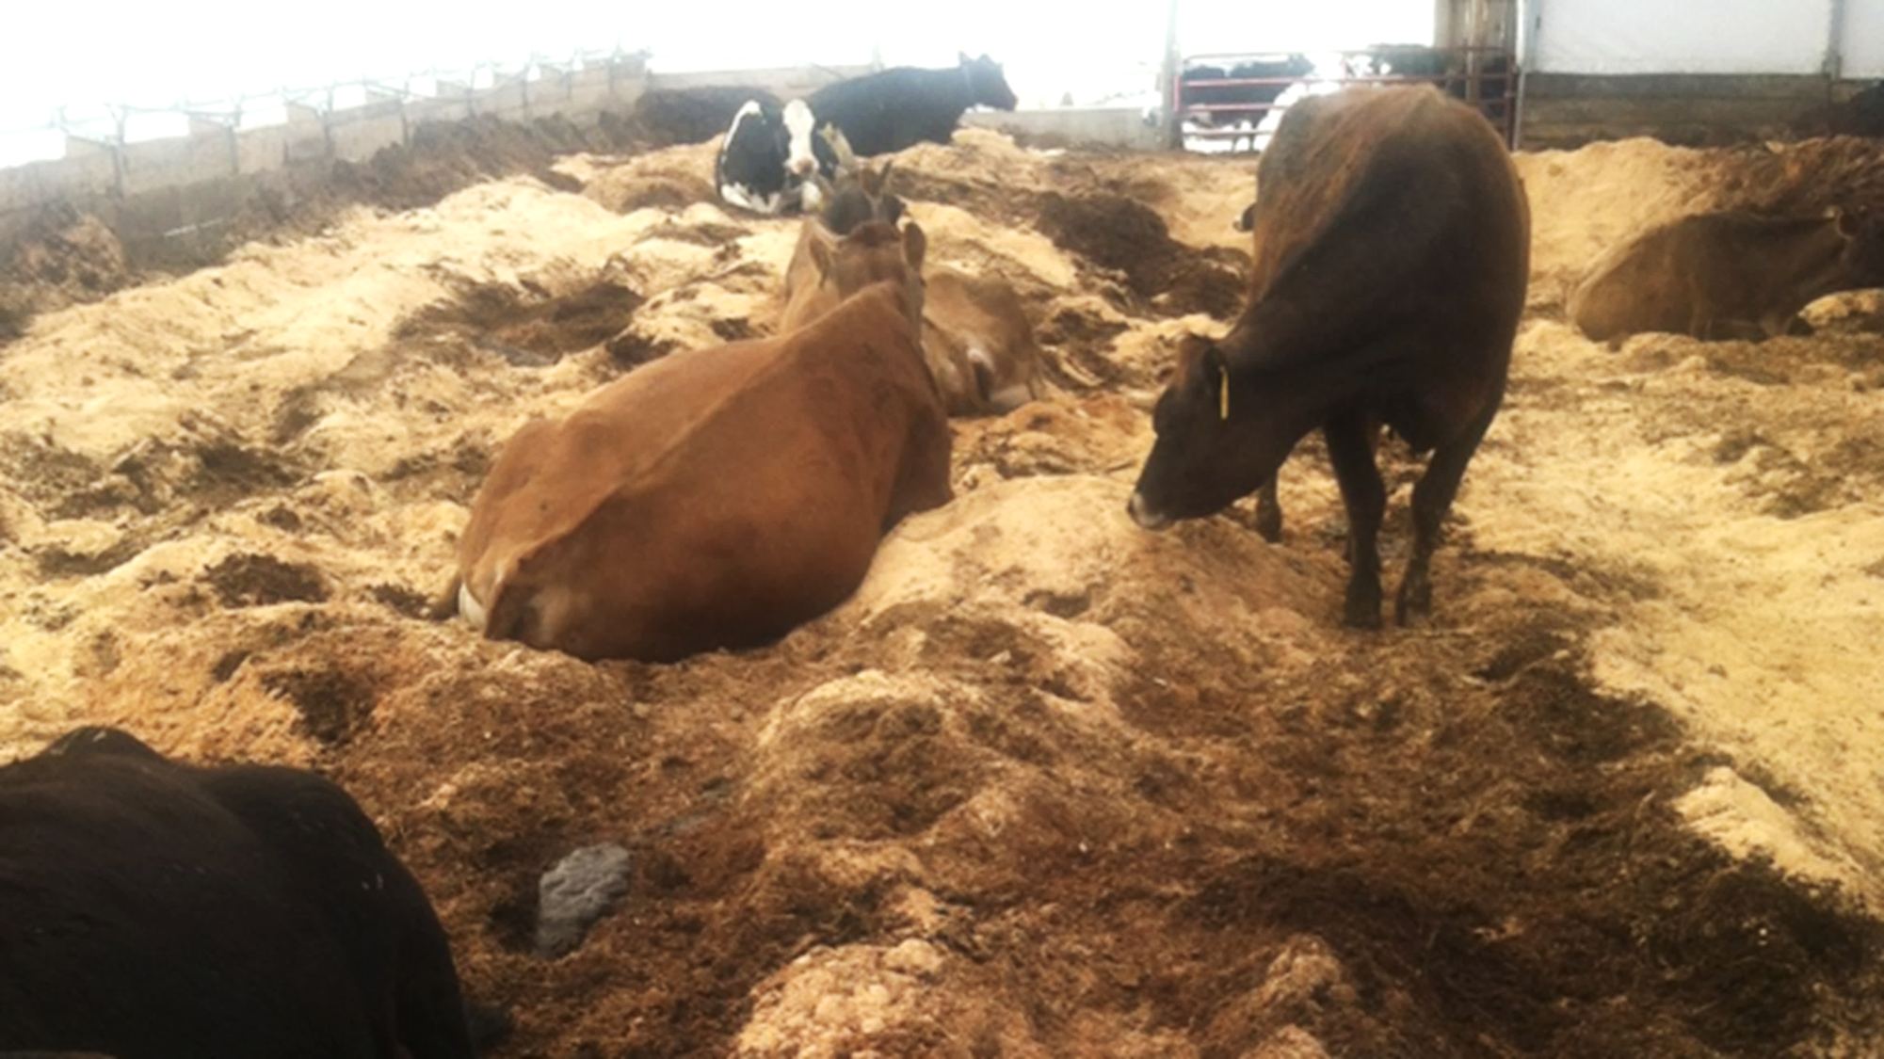
Despite living on a giant pile of their own manure and urine mixed with organic materials, cows on bedded pack do not necessarily experience more mastitis.
In fact, some research reports a decrease in mastitis after switching to bedded pack.

Slide 4
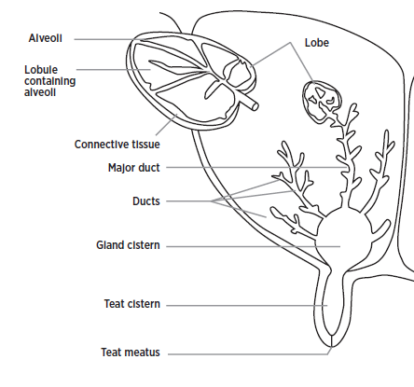

Teat Canal
Photo USDA-ARS
Michigan State University Extension
Notes:
A closer look at the mammary gland:
In the past 15 years, there has been an explosion in the use of DNA to assess the composition of the microbial community, allowing us to suggest an enormous diversity of microbial life far beyond that which can be grown in a petri dish. In the world of mastitis epidemiolygy this has lead to a reassessment of the nature of the host pathogen relationship. For many decades, healthy intramammary milk has been thought to be free of bacteria. Recent evidence has suggested that this may not be true. Instead, a diverse assemblage of microbial DNA has been observed in healthy milk, suggesting that the relationship between the udder and the microbial community may be more complex than "if a bacteria manages to establish itself in the gland, this gland is infected"

Slide 5
Traditional understanding
If a microbe(s) manages to establish itself in the gland, then this gland is infected
The dysbiosis hypothesis
The healthy gland contains microbes; infection is linked to a disruption of this ecosystem
Keeney, K.M., Yurist-Doutsch, S., Arrieta, M.-C., Finlay, B.B., 2014. Effects of Antibiotics on Human Microbiota and Subsequent Disease.
Notes:
The dysbiosis hypothesis, (“Put this in the back of your mind for a moment”)
disruption of the microbial ecology:
via invasion of a pathogen
“turning on” of pathogenicity of endogenous microbes,
or due to a chemical or physical imbalance in the gland, creating new ecological niches that allow commensal microbes to thrive, stimulating a greater cow immune response.

Slide 6
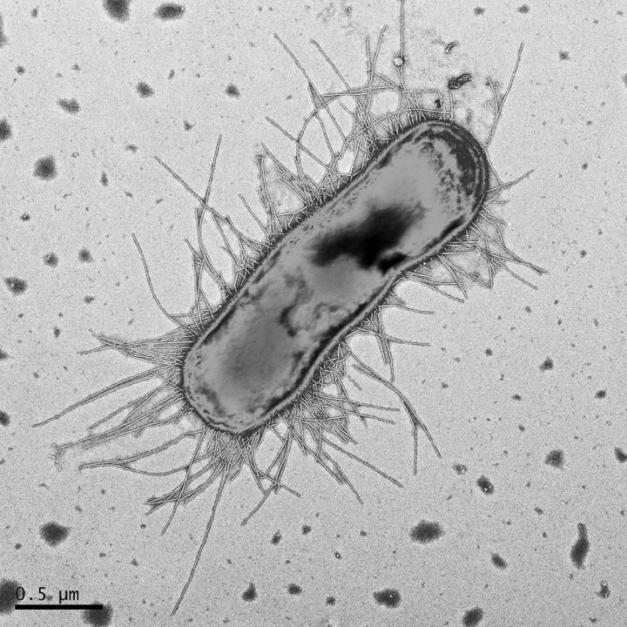
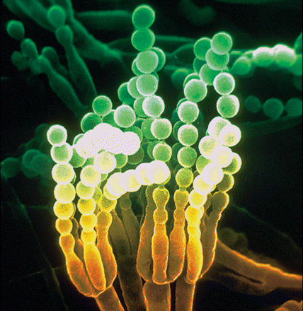
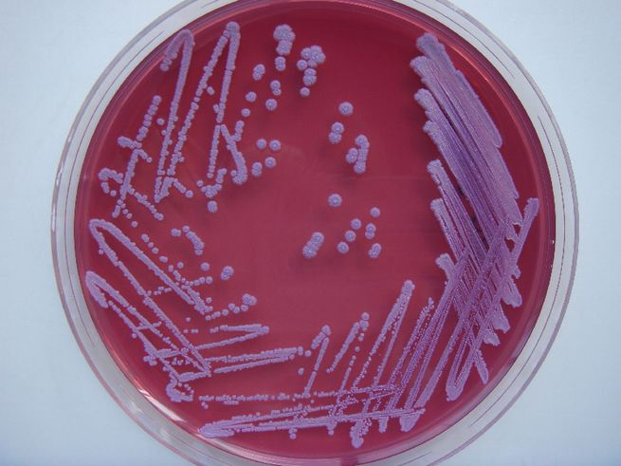

The Microbiome:
DNA-based Best Guess!
Dagmara Kisiela
USDA-ARS
L. Carrete
vs.
Notes:
Not counting microbes, only unique fragments of their DNA. So our long list of organism names that we found in these environments are best guesses. Often DNA sequences are identified only to order etc. For example, the jackalope DNA in our dataset is certainly a unique organism, but its DNA can only tell us it is related to the rabbit, because no one has ever found one before. So we are left calling it an OTU.
S aureus, penicillium chromogenes, escherichia coli

Slide 7

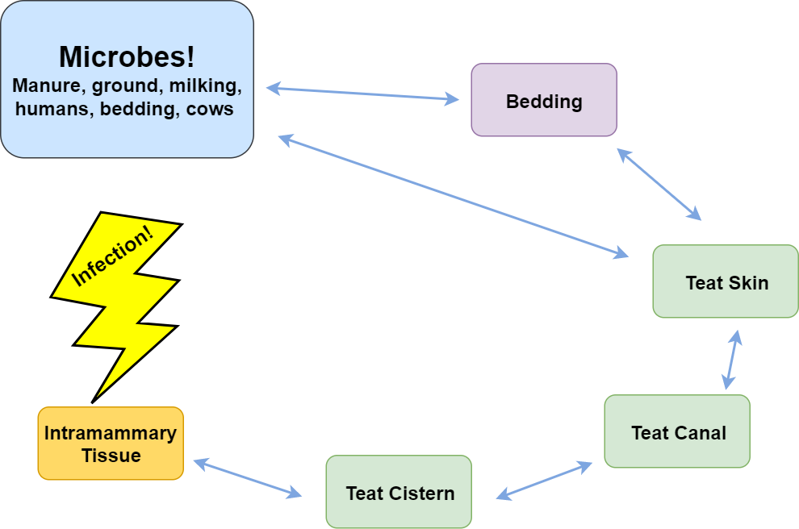
T. Andrews
Notes:
Organic farmers, such as those in this study, are unable to use antibiotics and rely on preventative measures to discourage mastitis. Bedding types and management can effect total pathogen load on teats and effect which bacteria are present in the bedding. Interestingly: the bedded pack style of bedding relies on the microbial community to decompose layers of substrate
Despite living on a pile of organic material mixed with their own feces, cows are no more likely experience mammary infections. What is going on here?

Slide 8
What bacteria and fungi are living in bedded pack, milk, and skin?
Do these organisms have an effect on mammary health?
Does bedding management change this community?
Questions
Notes:
We are hoping to gain insight into how bedded pack management can be used to control mastitis and curtail flies

Slide 9
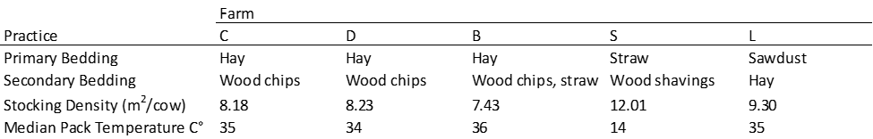
Experimental Design

Slide 10
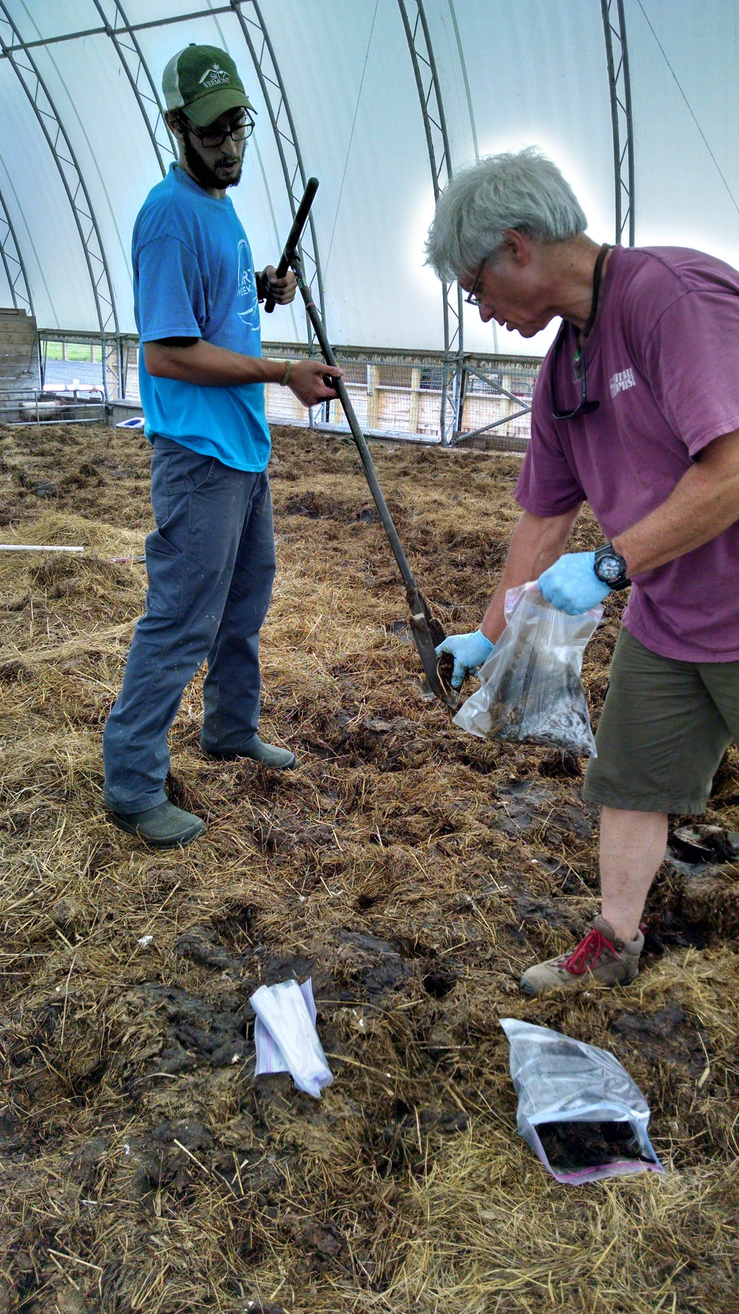
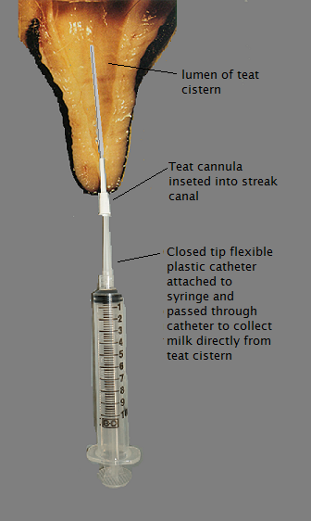
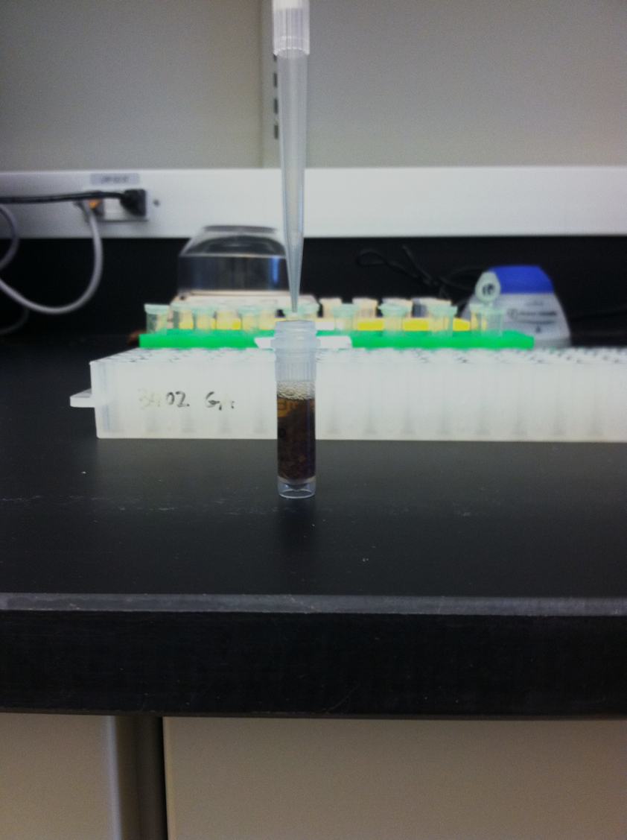
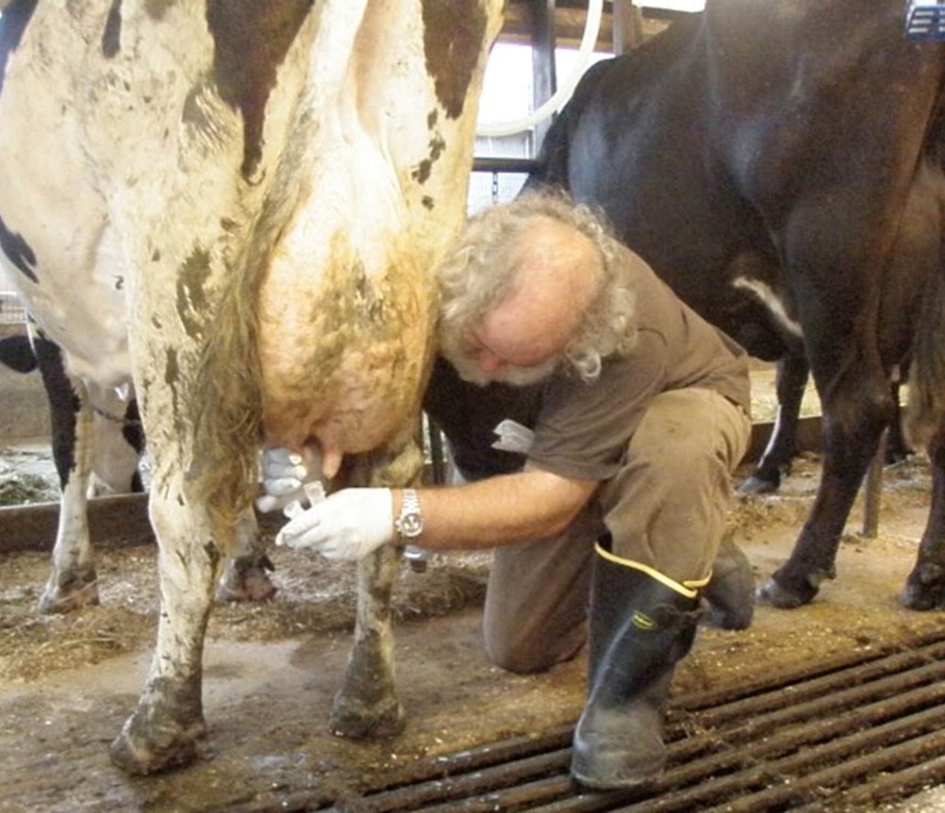
T. Andrews
J. Barlow
J. Barlow
D. Neher

Slide 11
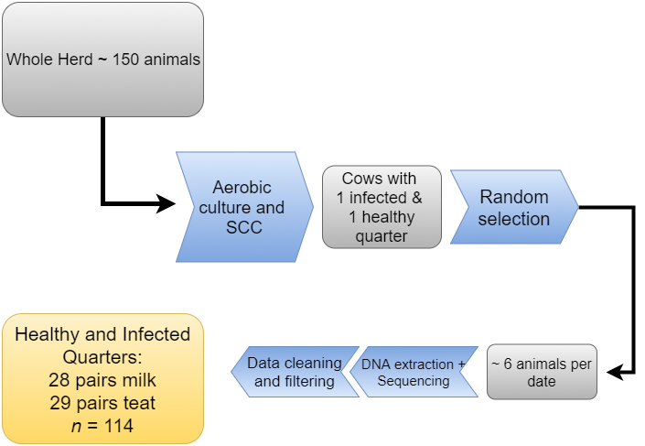
Notes:
Screened the herd to identify cows with one healthy and one infected quarter
Sequenced a random selection of these cows on each date.
Infected == SCC >= 200000 & positive ID of pathogen in replicate samples
Healthy == SCC <= 100000 & no growth in replicate samples

Slide 12
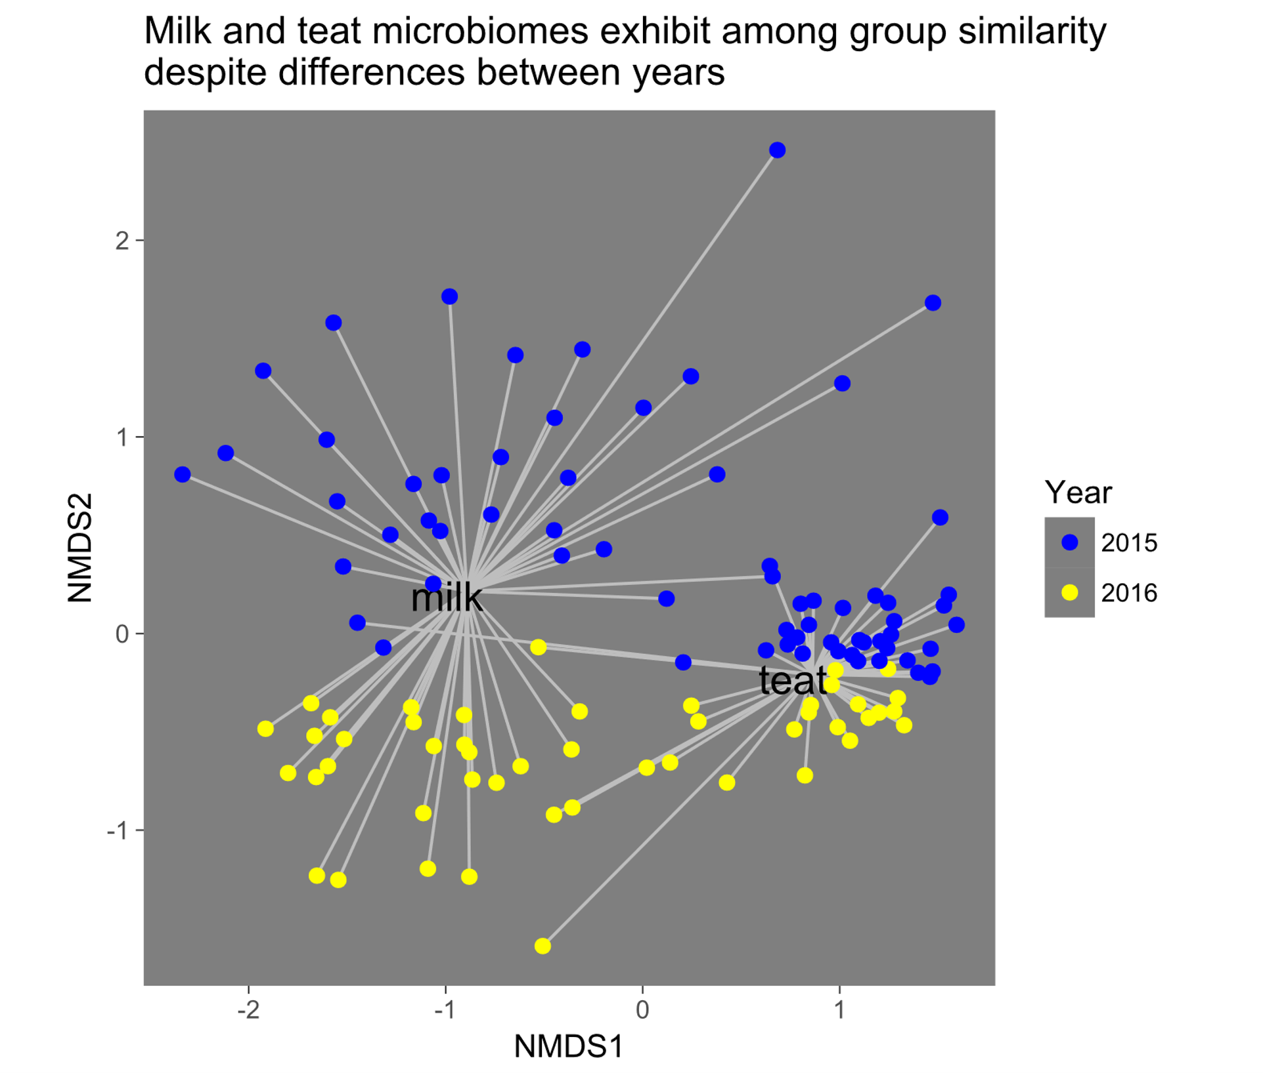
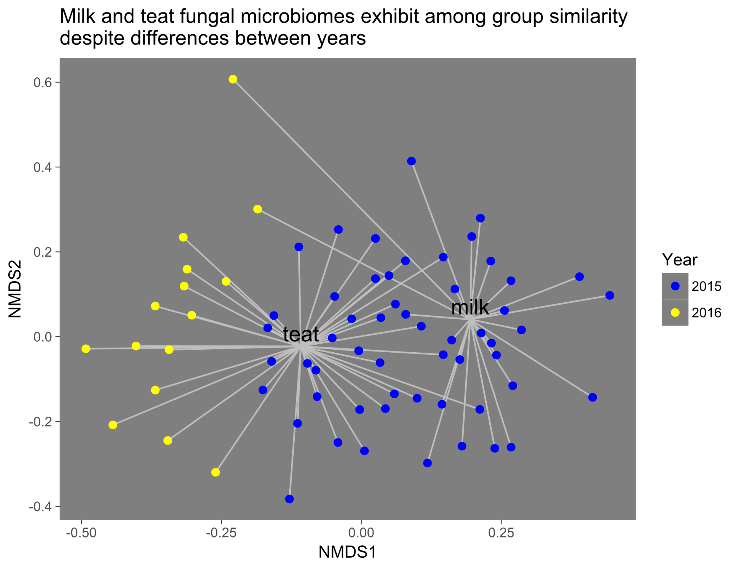
Microbiome differs between milk and teat
Bacteria
Fungi
Notes:
NMDS plots: points are samples of individual quarters, closer together means that samples have more similar microbiomes. line show the distance from the center of the sample type cluster
Milk and teat microbiomes are distinct.
Within sample type, 2015 and 2016 distinct: teat dipping? time effect? unclear: exactly confounded
For bacteria, milk microbiome exhibited more variability than teat, which are all quite closely clustered.

Slide 13
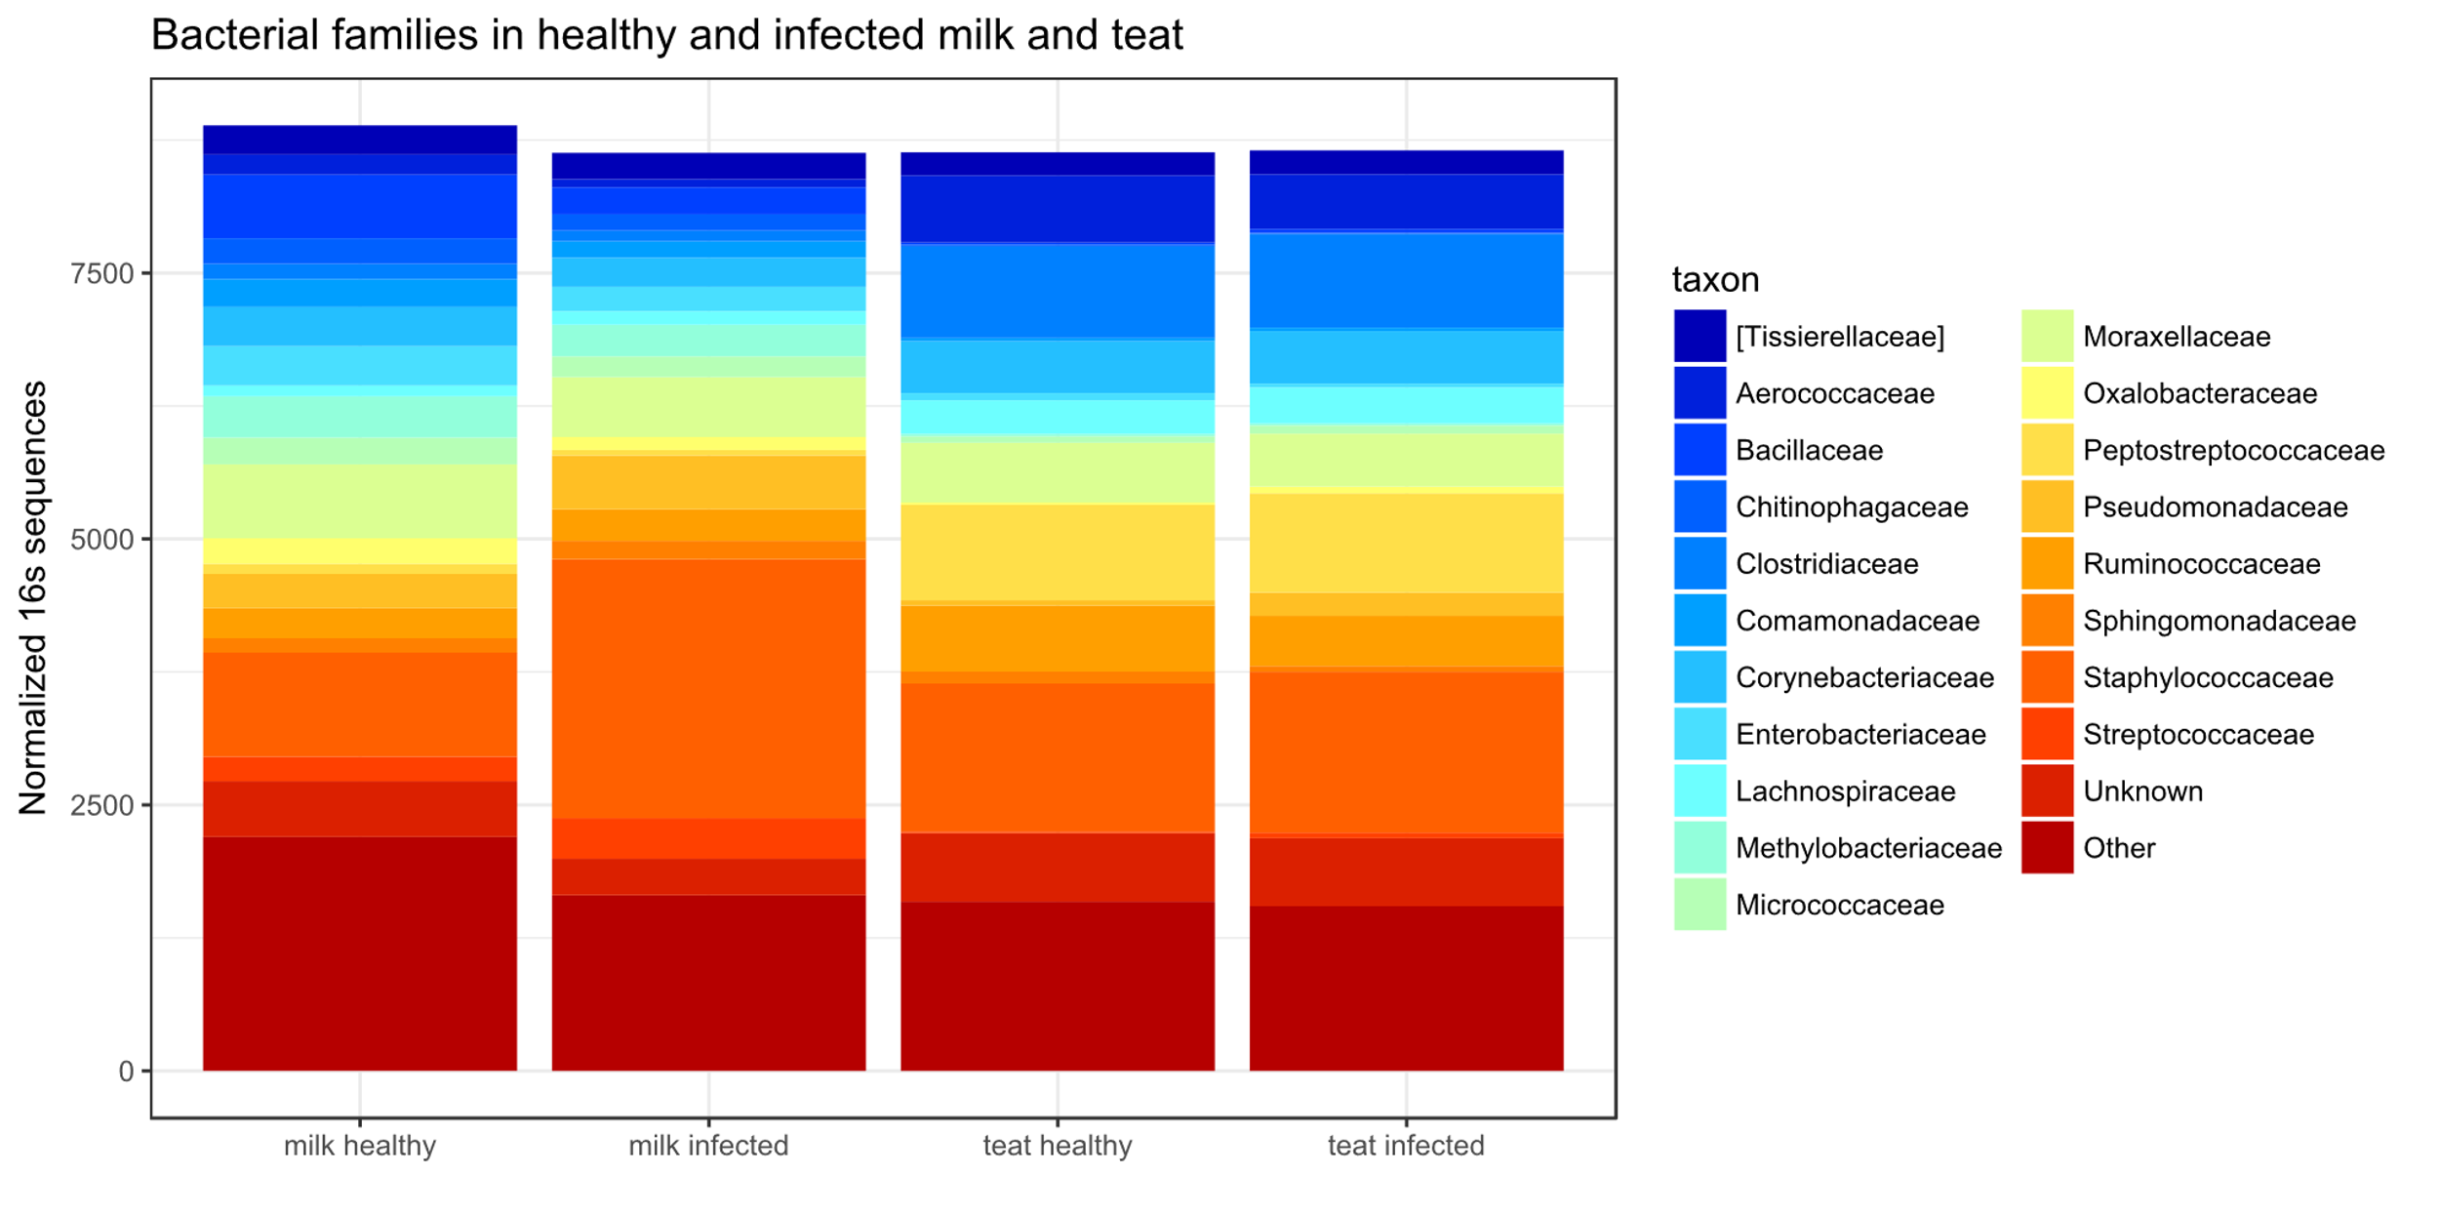
Infected milk microbiome is imbalanced
Notes:
Teat community similar
Milk community different: dominated by staph
Greater relative abundance of staphylococcaceae in infected milk, compresses other observed taxa. Unclear if they do not exist or less likely to be counted due to greater abundance of staph. Evenness of the infected community declines. Teat community is remains similarly distributed, and fewer taxa discrepancies are observed.

Slide 14
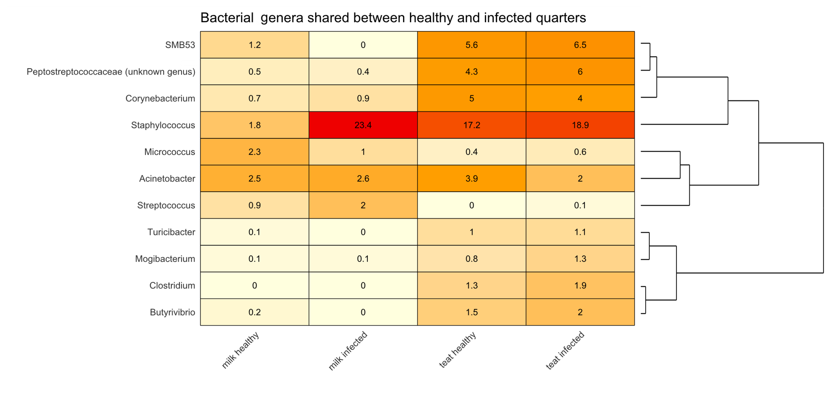
Milk microbiome changes in infected state
Notes:
Clusters: skin assoc vs milk associated groups, SMB53, abundant of skin, greater in healthy milk

Slide 15
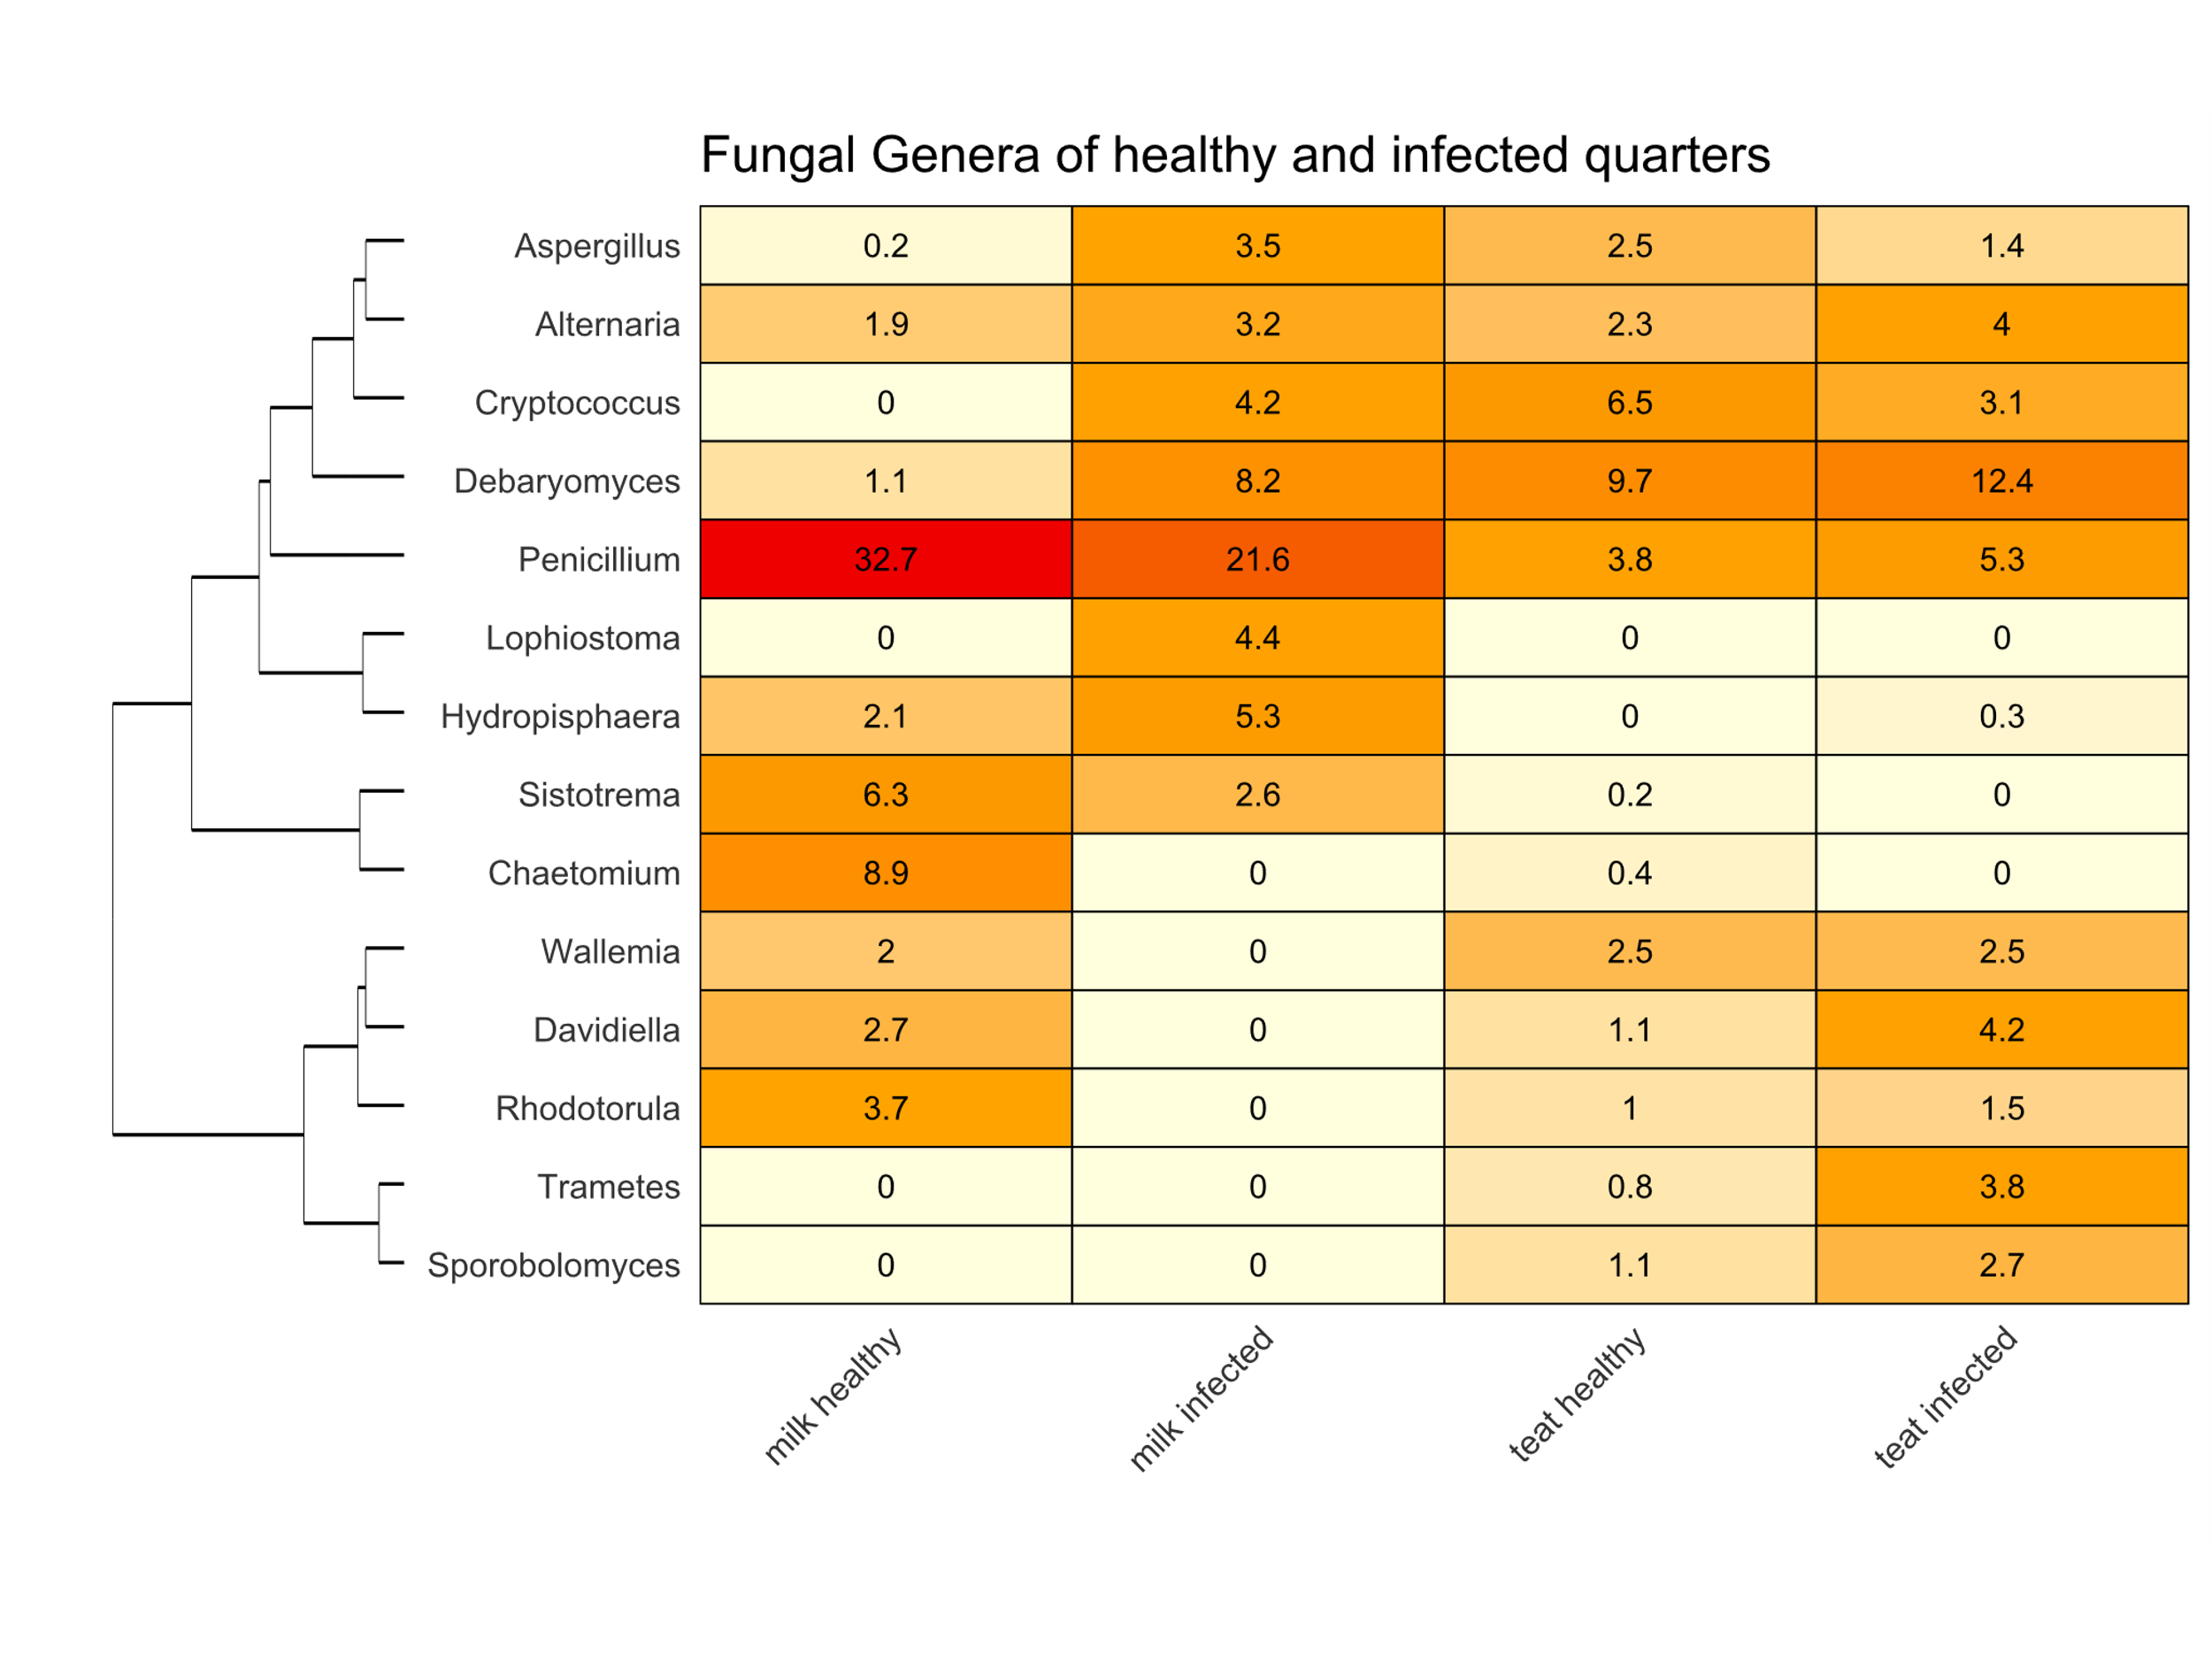
Same pattern in fungal sequences
Notes:
The same pattern in fungi: group of taxa that are only apparent in teat and healthy milk suggesting a flow of microbes between the healthy teat cistern and the bedding environment
Heavy hitter: penicillium greater in healthy milk, though prevalent in both healthy and infected milk, not really skin. Remember: these are Relative, there may actually be higher counts on skin, but less relative to other taxa.. Especially because many more sequences were read in teat samples.
Debaryomyces: yeast higher in infected samples and also found in skin. Lophiostoma, only found in infected milk.
Teat taxa in equal abundance are in different abundance between infection states: some are only present in healthy teats. Suggestive of a commensal milk microbiome that is shared with teat, and thus impacted by the external environment such as bedding. A sign that the healthy microbiota could be modulated by bedding.

Slide 16
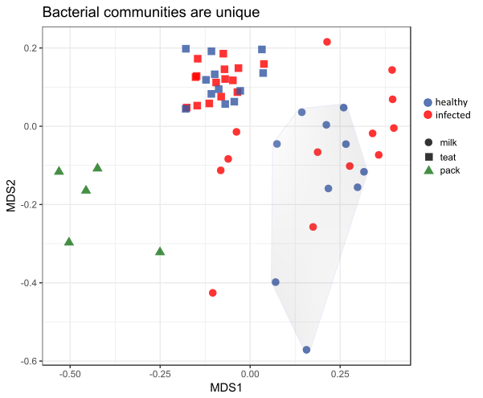
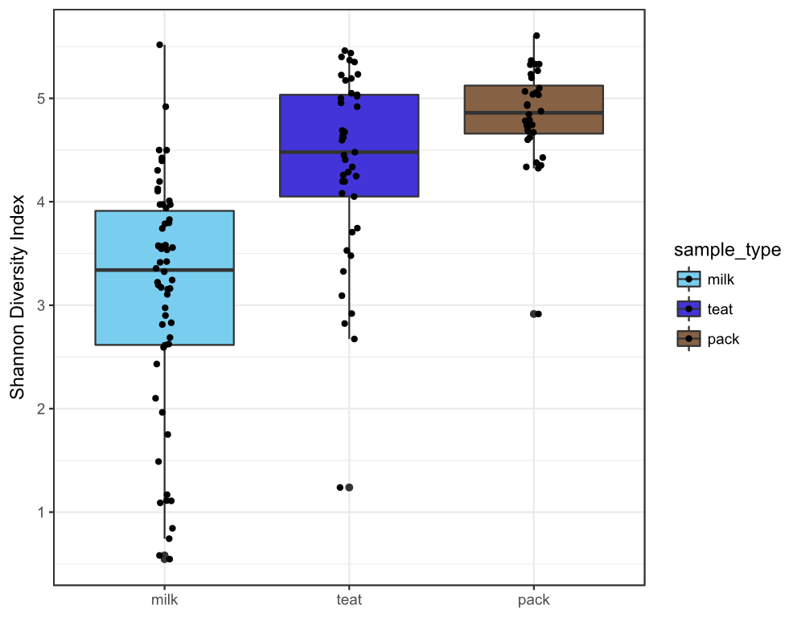

Slide 17
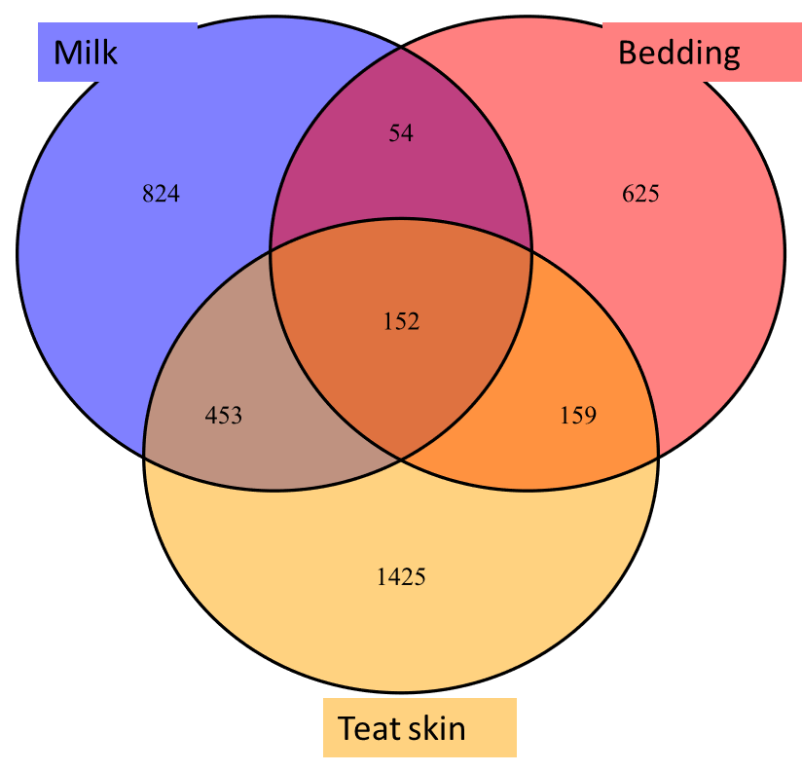
Bedding microbes in healthy quarters
Bedding microbes in infected quarters
Bacteria: teat skin and bedding healthy infected pack
Acinetobacter guillouiae 2.4 0.7 0.5
Acinetobacter lwoffi 0.9 0.1 1.1
Order Clostridiales 0.5 0.5 0.4
Bacteria: milk and bedding
Pseudomonas umsongensis 1.5 0.5 0.1
Ochrobactrum sp. 0.9 0.5 0.1
Acinetobacter guillouieae 1.0 1.3 0.5
Fungi: teat skin and bedding
Debaryomyces prospidis 13.5 19.7 4.1
Kingdom fungi 1.3 0.2 0.2
Penicillium chrysogenum 1.7 1.1 0.1
Fungi: milk and bedding
Debaryomyces prospidis 1.1 4.1 4.1
Notes:
Bacterial genera greater than or equal to 2.5% and Fungal genera ≥5% of total relative abundance in teat or mammary gland also present in bedded pack. Green cells are shared taxa greater in healthy glands, Yellow cells are bedding taxa increased in infected glands.
Debaryomyces and penicillium shared between all habitat states
Corynebacterium and Acinetobacter shared between both habitat states

Slide 18
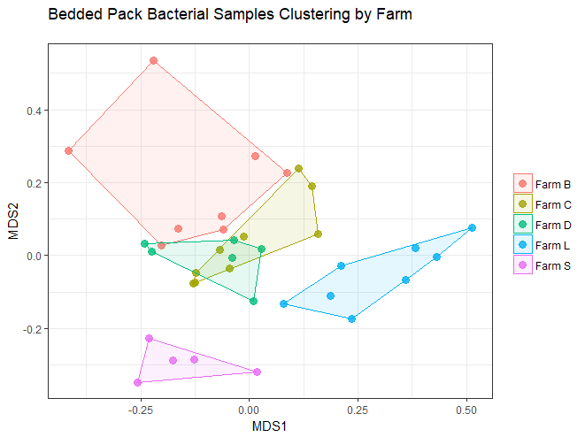
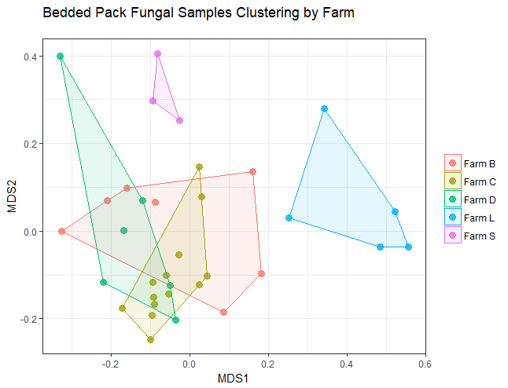
Bedding microbiome shaped by farm and bedding style
Notes:
So if we believe that there are microbes associated with both healthy and infected habitats present in the bedding, is it possible to control this environment to foster the good microbes and discourage the bad ones?
The microbiome of the bedding did appear to be shaped both by farm and by management practices. BDC all clustering : all warm static packs while other two farms are set apart.

Slide 19
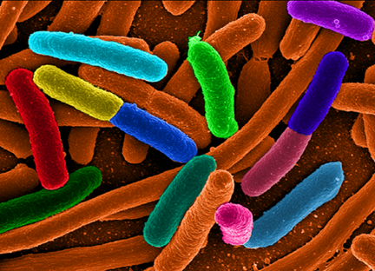
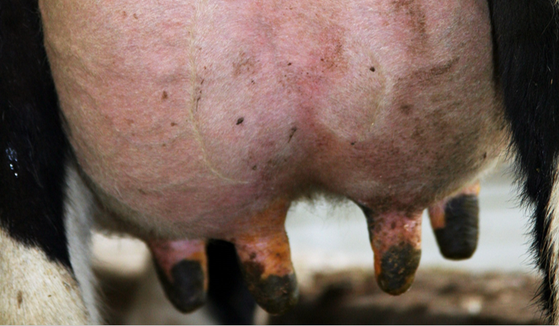
Conclusions
The bedding and mammary environments contain diverse microbial DNA
Teat microbes are shared with milk differently in the infected state
Bedding microbes found on healthy and infected teat skin and milk
Management practices impact bedding microbial community
Notes:
Q’s: Single cow that gets mastitis over time
Compare gut and milk microbiome: immune resistance conferred by bacteria, diet
Genotyping staph species : where are the truly pathogenic bacteria residing
Continue to characterize the microbiome with molecular genetic studies: what are these things actually doing?

Slide 20
New Questions
Is the mammary microbiome shaped by bedding strategy?
Is there a core healthy mammary microbiome that is shared between all cows regardless of bedding, farm, diet etc?
Do bedding microbes inhibit pathogens?
Can bedding management be used to promote “healthy microbes”?

Slide 23
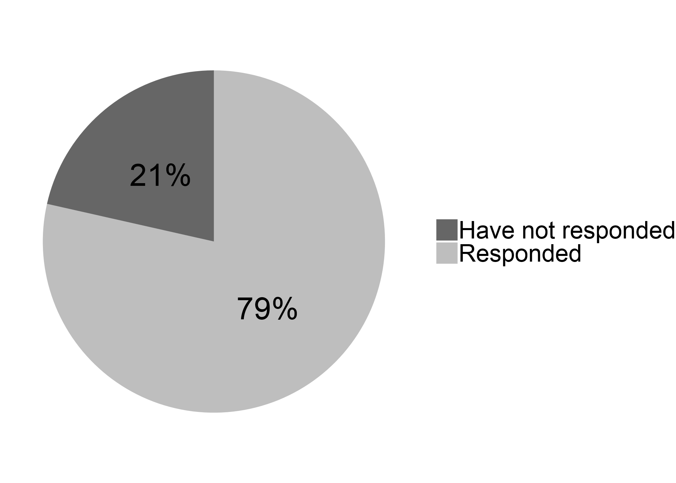
Objective One
Industry wide survey results
177 Vermont organic dairies

Slide 24
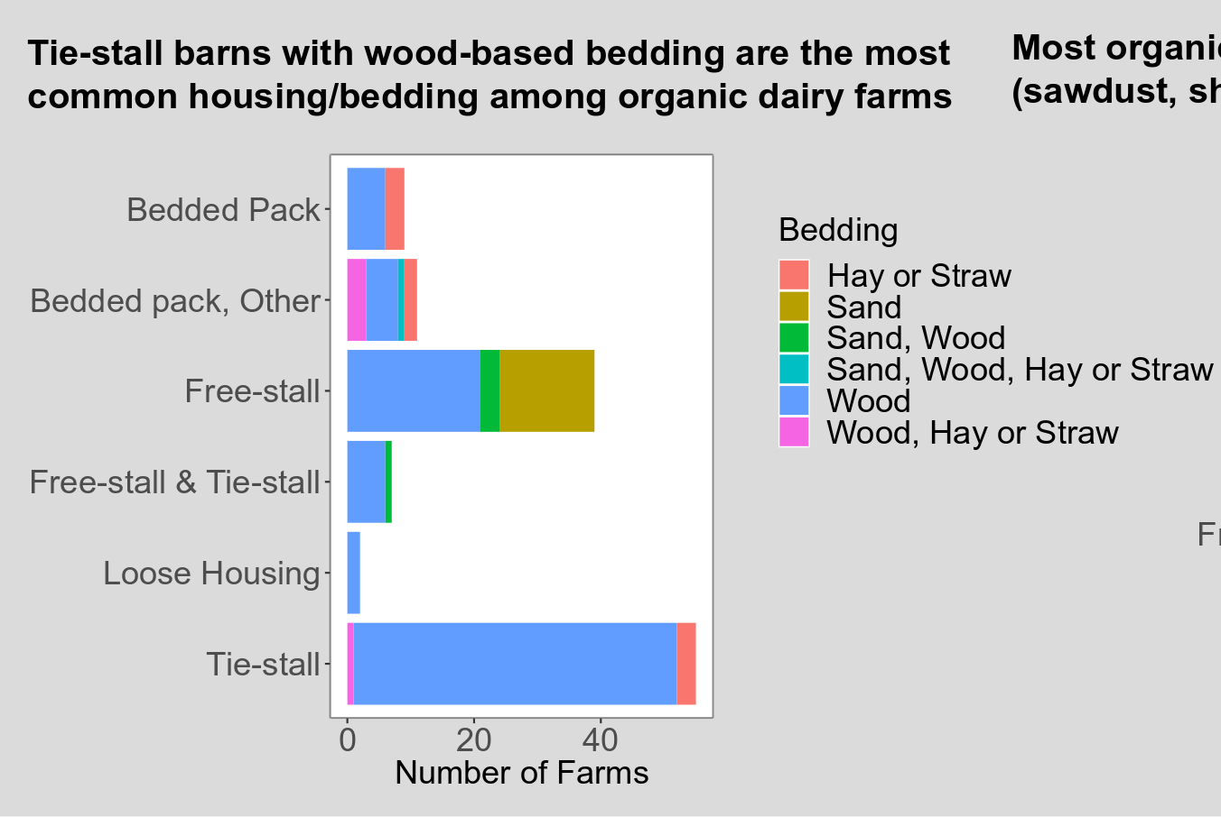
Treatment groups chosen:
Bedded pack (+ Bedded pack, Other if >60%)
Free-stall bedded w sand
Free-stall bedded w wood
Tie-stall bedded w wood
Challenge: bedded pack is extremely variable and few farms use similar bedded materials, recipes or time spent on pack

Slide 25
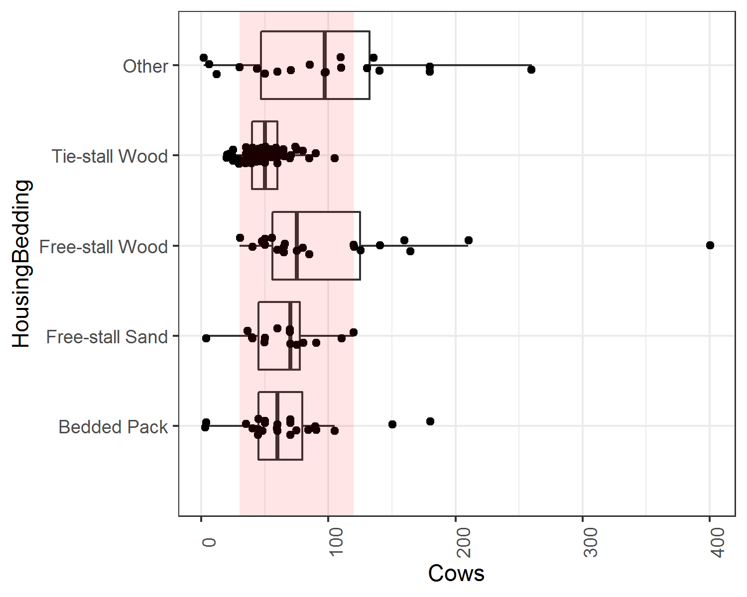
Restrict sample population:
Number of cows per farm
Sample within the pink band
10-90th quantile

Slide 26
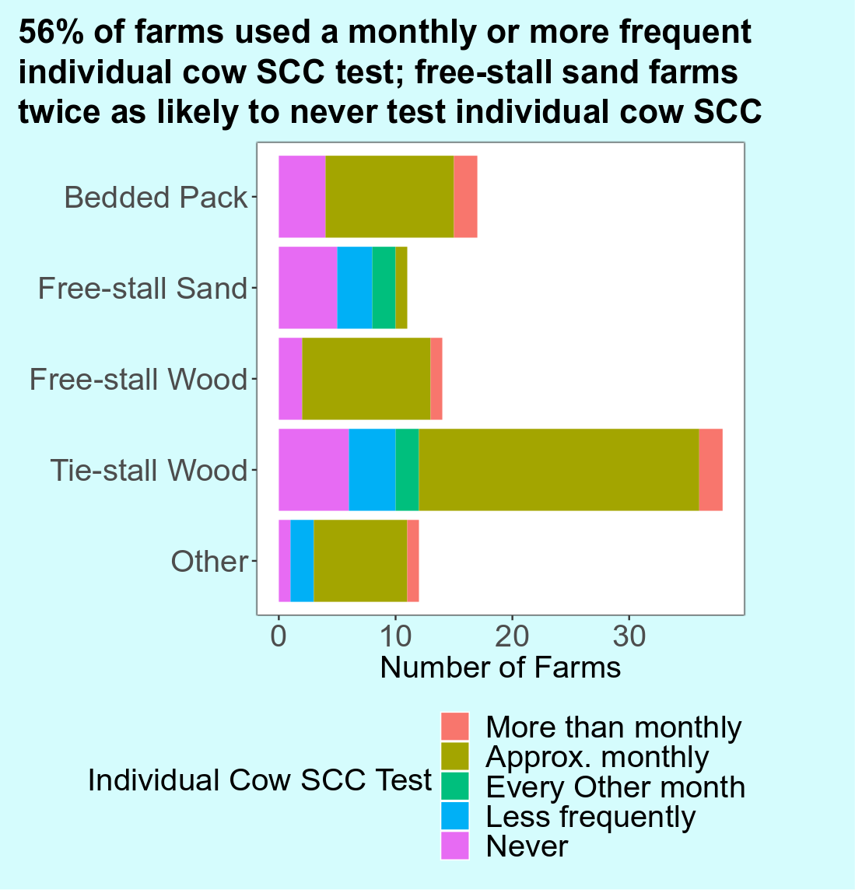
Restrict sample population:
Farms that use monthly individual cow SCC testing service (year 1 and 2)
Farms that are willing to accept this service for several months around time of sampling (year 2)

Slide 27
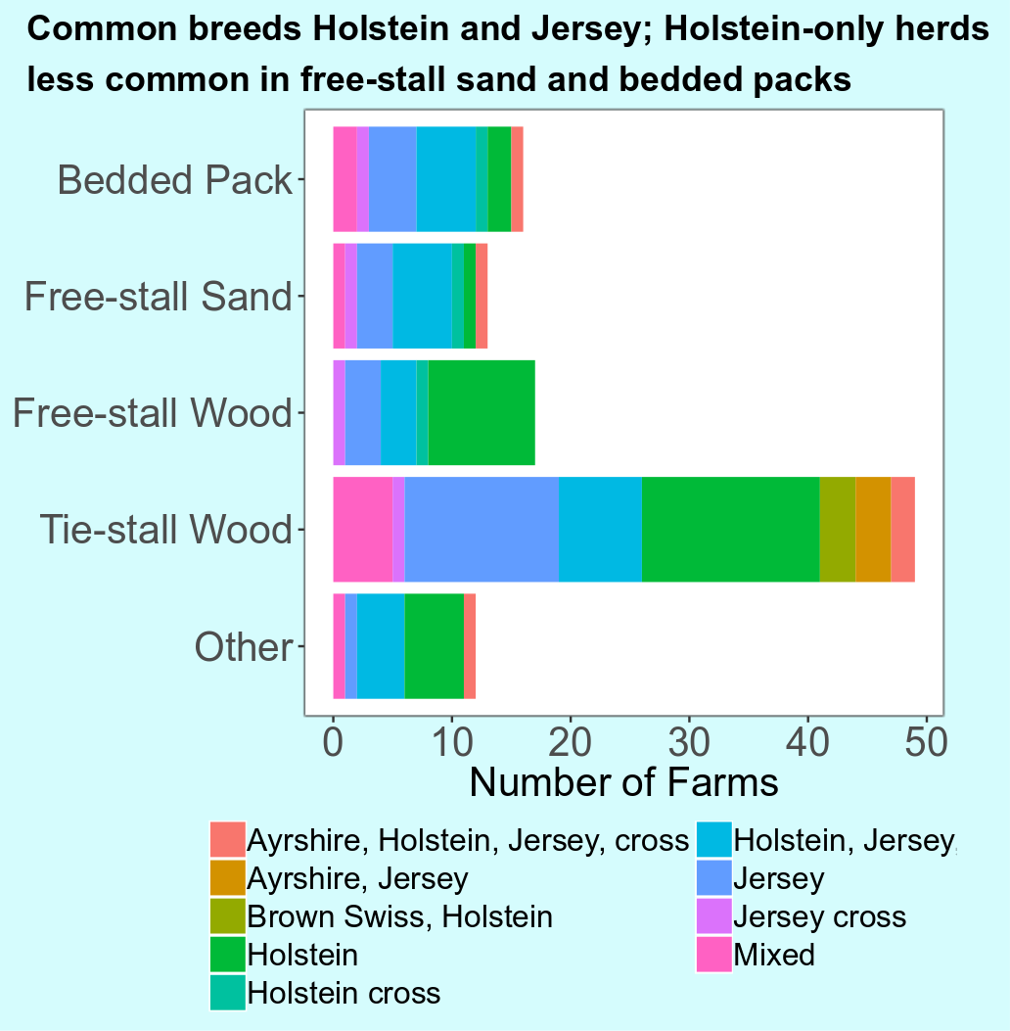
Breed:
do not restrict or stratify sample population. Too restrictive and too much variation to be meaningful in this design.

Slide 28
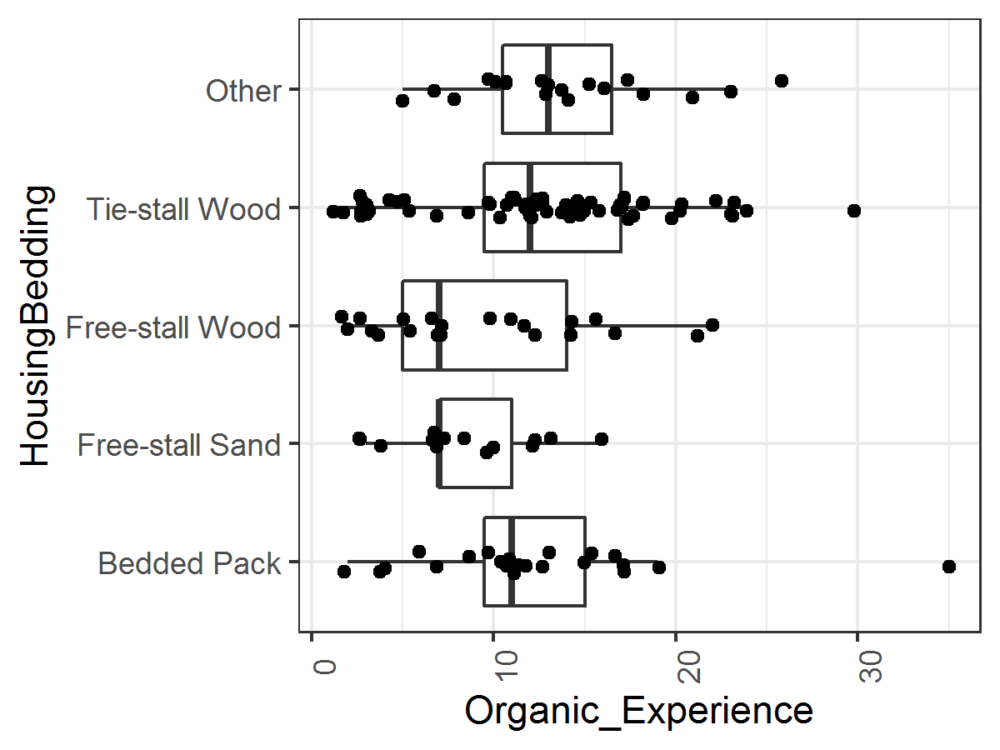
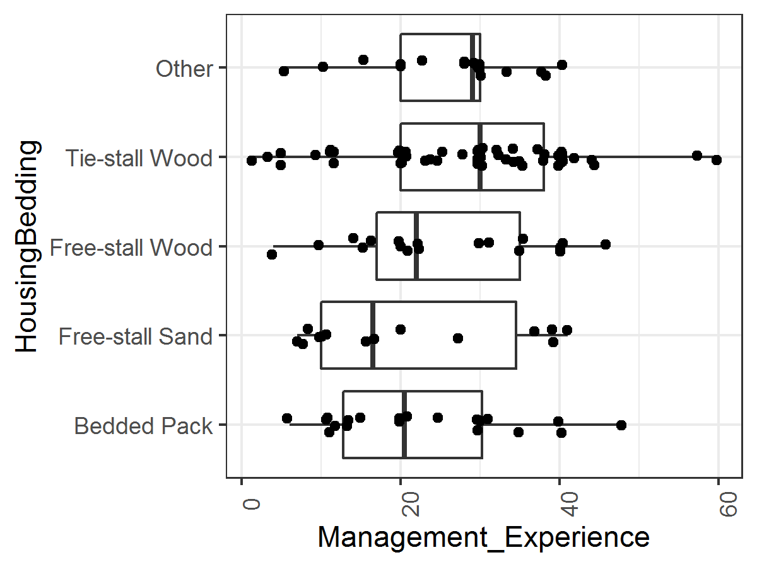
Management Experience: do not restrict sample population

Slide 29
Farms that can be recruited (ten of each):
16 Bedded Pack (some may be split systems)
13 Free-stall sand
20 Free-stall wood
41 Tie-stall wood

Slide 30
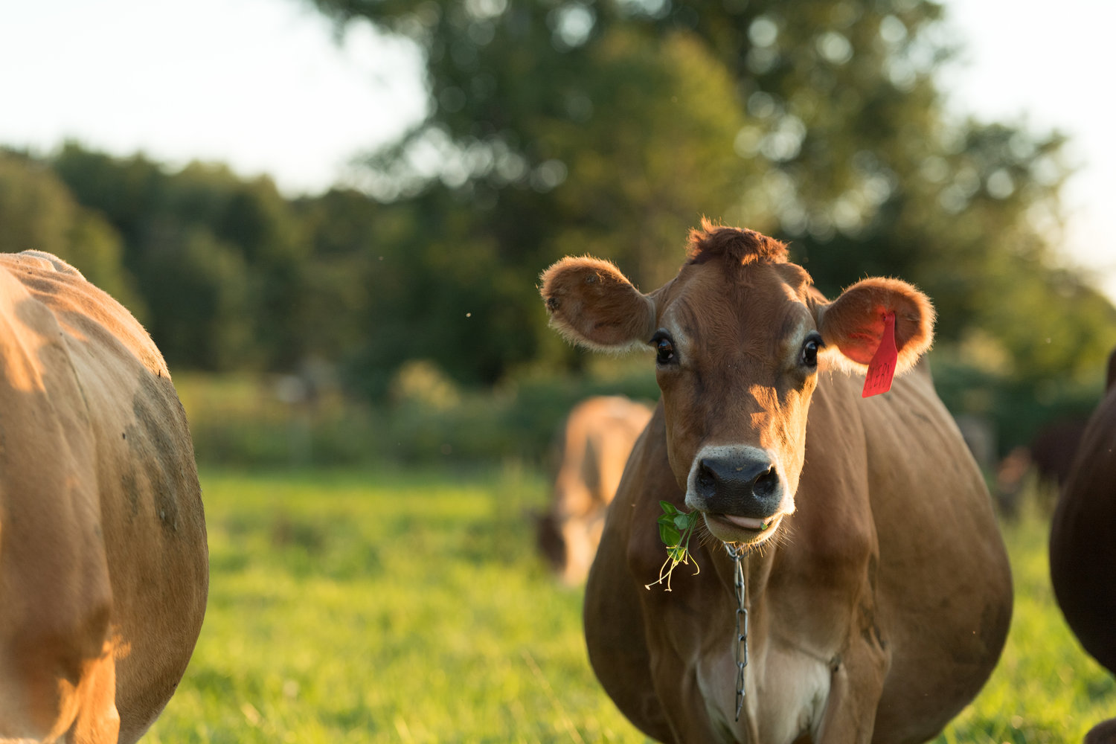
OBJECTIVE 1:
40 Herd Survey
Photo: Melanie Webb

Slide 31
OBJECTIVE 1:
Assess current bedding management practices, mastitis management, animal health and milk quality on northeastern organic dairy farms
Enroll 40 organic milk producers to collect data from in-person interviews, on-farm observations, and samples for analysis

Slide 32
Target population:
All organic dairy farms in Vermont
Exclude very small and very large herds
Source population:
Organic dairy farms in Vermont with a herd size of 35 to 120 lactating cows and test monthly through DHIA
Stratify on housing/bedding type
Initial Study sample population:
Randomly select farms from each of 4 housing type groups
Source population:
Organic dairy farms in Vermont with herd size of 35 to 120 lactating cows
Exclude herds not on monthly DHIA
OBJECTIVE 1: 40 HERD STUDY

Slide 33
40 Representative farms:
Organic dairy farms in Vermont with target herd size (35 to 120) and on DHIA (monthly)
Bedded pack (10)
Free stall: wood bedding (10)
Tie stall: wood bedding (10)
Free stall: sand bedding (10)
Sequentially enroll randomly selected herds from each non-bedded pack group until sample population identified –confirm factors such as monthly individual cow SCC testing, and winter housing variation.
Consider adding additional herds not on DHIA but willing to temporarily enroll for study
OBJECTIVE 1: 40 HERD STUDY

Slide 34
OBJECTIVE 1: Survey tool
Concerns about bedding/mastitis risk
How they may manage any chronically mastitic cows
How they identify/track mastitis
Milking facilities, procedures and udder hygiene
Dry cow management
Diet, vitamin/mineral supplementation, water source
Typical calving and periparturient practices
Fly control
OBJECTIVE 1: 40 HERD STUDY

Slide 35
OBJECTIVE 1: Survey tool
Type of housing system
Both lactating and dry
Bedding management for each housing type used
Both lactating and dry
Classification and description of any bedding material used
Both lactating and dry
Some basic herd information (production, number of lactating/dry/youngstock, breeds, record-keeping system)
OBJECTIVE 1: 40 HERD STUDY

Slide 36
OBJECTIVE 1: Survey tool: bedded packs
Bedded packs
How manage (addition materials, surface management)
Monitor moisture, temperature, density?
How is this done?
How constructed
Bedded packs vs. previously used systems
OBJECTIVE 1: 40 HERD STUDY

Slide 37
OBJECTIVE 1: Survey tool
KoBoToolbox
Free, open-source survey data software
Build customized form with variety of question types
Collect data online/offline with tablet
Analyze and manage forms online
Export to Excel
OBJECTIVE 1: 40 HERD STUDY

Slide 38
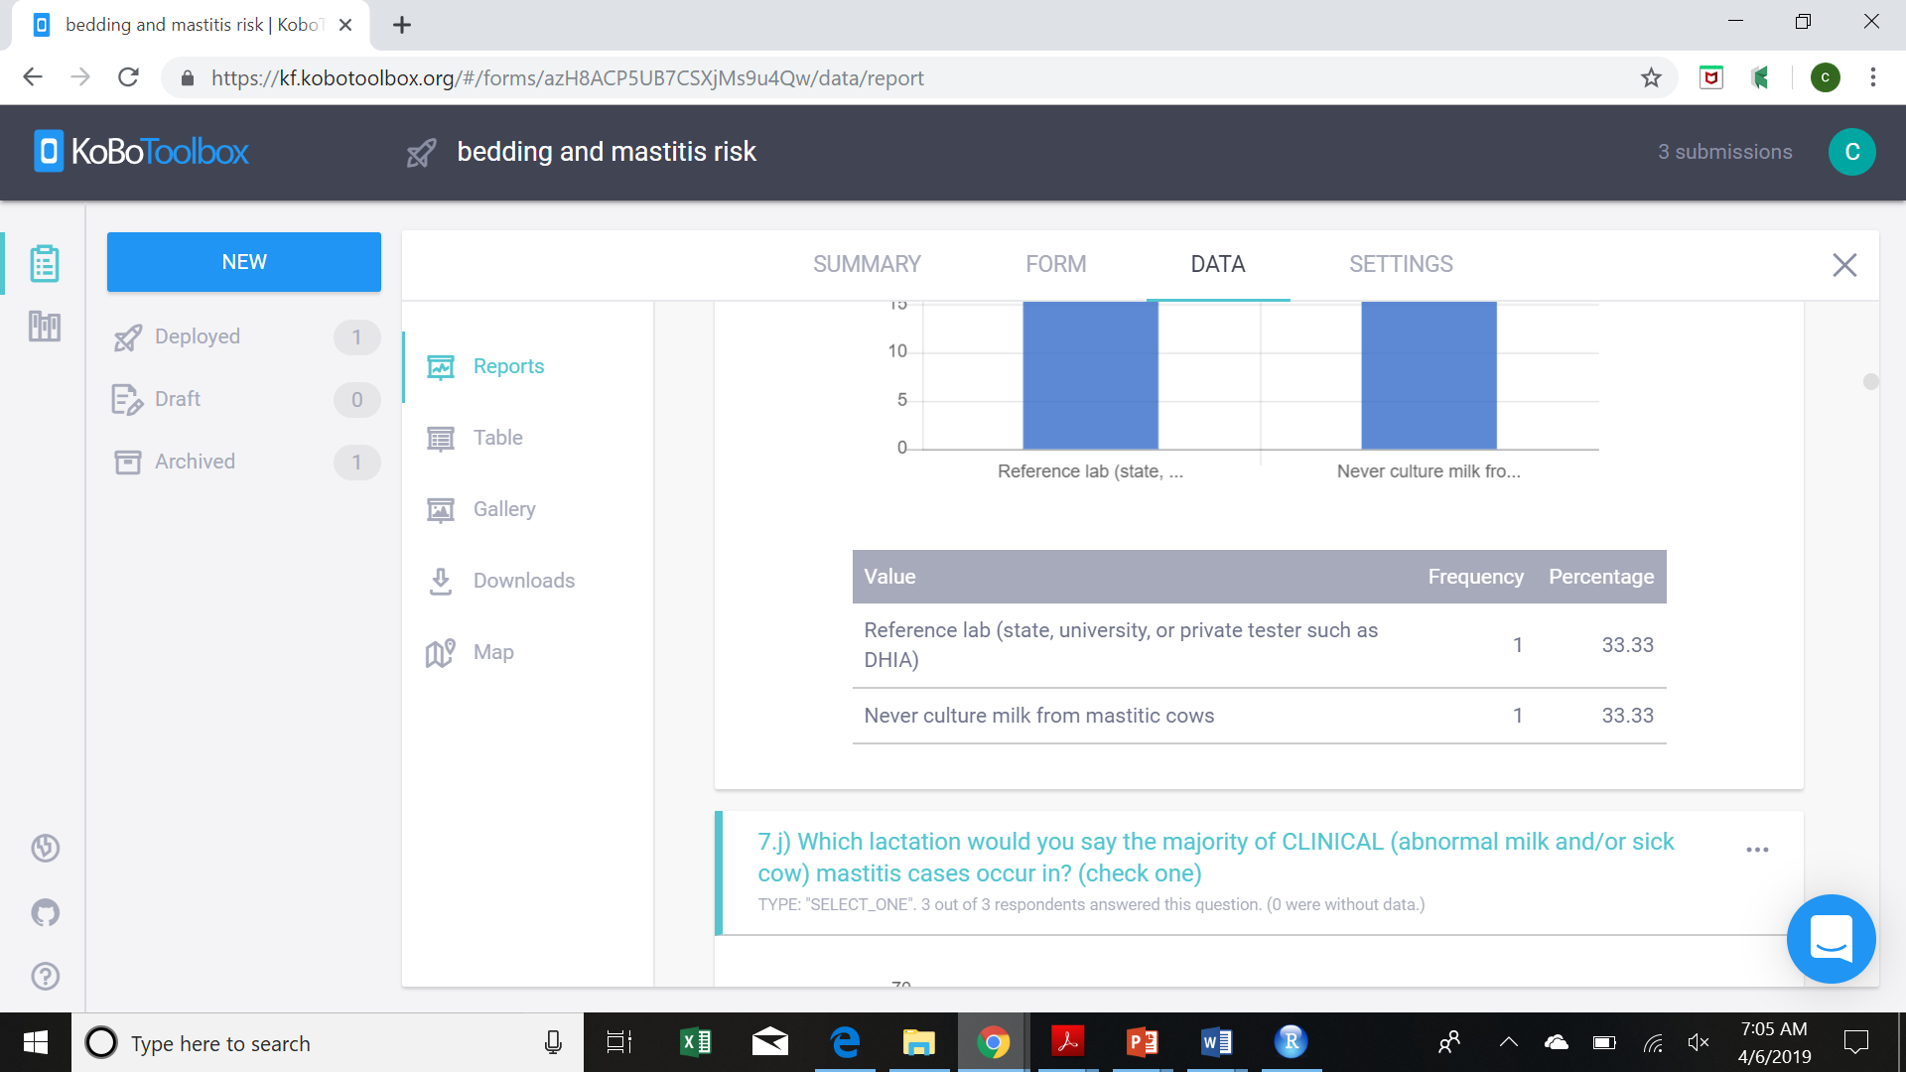
OBJECTIVE 1: Survey tool
OBJECTIVE 1: 40 HERD STUDY

Slide 39
OBJECTIVE 1: On-farm observations
Bulk tank information, cow ID, air quality
Free and tie stalls
Stall sizes, how are they cleaned
Free stalls
Pen sizes and layout, stocking density
Tie stalls
Number of stalls, trainers
Bedded pack
Size, number cows, sq. feet per cow, depth, temperature
Outdoor turn-out area
Size, stocking density, surface description
Hygiene scoring
OBJECTIVE 1: 40 HERD STUDY

Slide 40
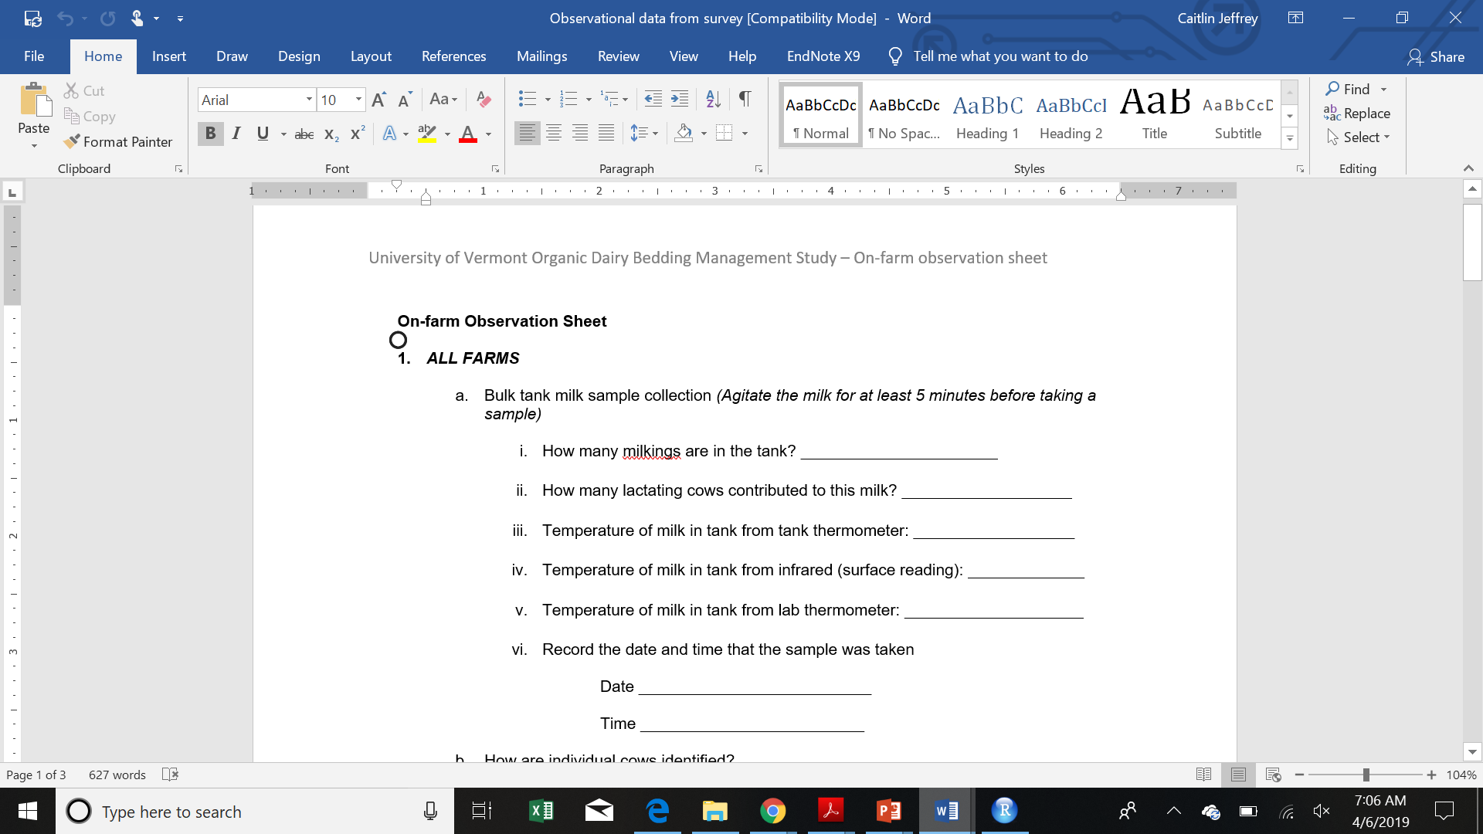
OBJECTIVE 1: On-farm observations
OBJECTIVE 1: 40 HERD STUDY

Slide 41
OBJECTIVE 1: Prospective mastitis culturing
Leaving enough materials to culture 20 cows that develop clinical mastitis over the next month
Producer to take sample, freeze, and we will collect
Pathogen identification by culture
May also be high SCC cow (identified by us or them)
OBJECTIVE 1: 40 HERD STUDY

Slide 42
Bulk tank milk
(1 x 250 mL dipper)
FRESH [2 x 35 mL] to St. Albans Coop for “Cheese-maker profile” (MUN, components, bacteriology)
FROZEN [2 x 35 mL] to U. Minnesota for aerobic culturing
FROZEN [15 mL] to UVM for: A. Collecting isolates by culture (10 mL) B. PCR for pathogens (4 mL)
FROZEN [1 mL] to U. Colorado Boulder for metagenomic analysis (bacterial and fungal sequencing)
OBJECTIVE 1: 40 HERD STUDY

Slide 43
Bedding
~ 1 gallon Ziplock
Lactating + Dry
FROZEN [2 cups] to U. Minnesota for standard aerobic bedding culture
FRESH [1 cup]/ FROZEN [1 cup] to UVM for: A. Collect isolates/inhibitors [frozen] B. % moisture analysis [fresh]
FROZEN [1 tbsp.] to U. Colorado Boulder for metagenomic analysis (bacterial and fungal sequencing)
OBJECTIVE 1: 40 HERD STUDY

Slide 44
Individual cow samples
(14 mL snap-cap tubes)
Collected by producers over 30 days after survey
FROZEN [14 mL] to UVM for collecting isolates of pathogens by culture
OBJECTIVE 1: 40 HERD STUDY

Slide 45
OBJECTIVE 1: Limitations and mitigations
Lack of producer mastitis records
DHIA
Lameness scoring
Body condition scoring
Plane of nutrition/trace mineral status
Survey tool
OBJECTIVE 1: 40 HERD STUDY

Slide 46
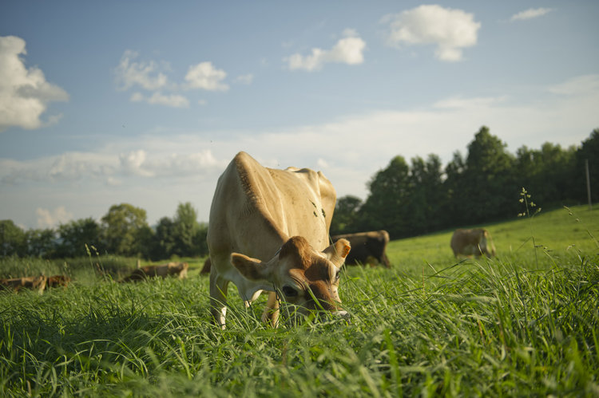
Questions, comments?
Photo: Melanie Webb

Slide 47
Bulk tank milk
1 x 250 mL dipper
FRESH [2 x 35 mL] to St. Albans Coop for “Cheese-maker profile” (MUN, components, bacteriology)
FROZEN [2 x 35 mL] to U. Minnesota for aerobic culturing
Bedding
1 gallon Ziplock
Lactating/Dry/Winter turnout
FROZEN [2 cups] to U. Minnesota for standard aerobic bedding culture
FROZEN [15 mL] to UVM for: A. Collecting isolates by culture (10 mL) B. PCR for pathogens (4 mL)
FROZEN [1 mL] to U. Colorado Boulder for metagenomic analysis (bacterial and fungal sequencing)
FRESH [1 cup]/ FROZEN [1 cup] to UVM for: A. Collect isolates/inhibitors [frozen] B. % moisture analysis [fresh]
FROZEN [1 tbsp.] to Colorado Boulder for metagenomic analysis (bacterial and fungal sequencing)
OBJECTIVE 1: 40 HERD STUDY

